Slide 1
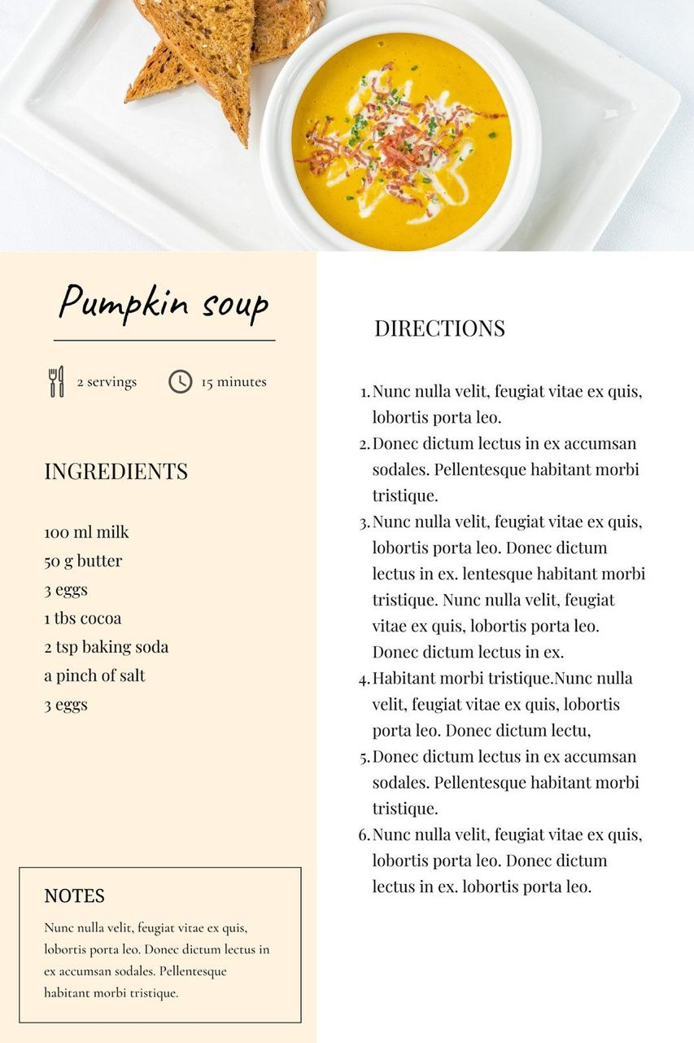
FOOD RECIPE SUGGETIONS USING PYTHON PROGRAMMING
Team members :
V.Hari (192211173)
V. V. Chakravarthi Dhanush(192211317)
S. RAKSHAN(192220005)
Reddy Prasad B(192119023)
Devadarshan K(192224040)
Girish kumar B(192210500)
Dr.Raveena

Slide 2

CSA0827 - PYTHON PROGRAMING FOR WEB APPLICATIONS
MINI PROJECT - FEB 2024
Dr.Raveena

Slide 3
Abstract
The proposed project aims to develop a personalized recipe recommendation system to address the common issue of monotony in home-cooked meals, which often leads individuals to opt for less healthy restaurant or junk food options. The system will consist of a user-friendly Android application equipped with machine learning capabilities, particularly leveraging TensorFlow, a free open-source library. Users will be able to scan the fruits and vegetables they have available, and the application will generate a curated list of recipes tailored to their preferences and health conditions.

Slide 4
Introduction
Food is one of the main human needs.
Through food is the source of energy obtained.
In its development food today is not only as a filler of energy needs, but more than that food has become an art and has added value.
A wide variety of innovative creations in food have been developed and spread widely.
Many of them use only the minimal amount of material to create an original recipe .
A recipe consist of a set of instructions that tells us how to prepare and cook food, which include a list of what food is needed for .
Cooking recipe consists of several aspects including: name, step, tools and materials, time and amount of dish. Not everyone can memorize well the recipes they want.
Their material is also an obstacle in cooking. Limited ingredients also become one of the causes of limited cooking creations, especially for someone who does not have passion in cooking.
9

Slide 5
PROPOSED MODEL
The proposed work will involve several key steps:
Ingredient Scanning: Users can scan the fruits and vegetables they have available using the mobile application.
Real-time Analysis: The system analyses scanned ingredients in real-time to identify available items for recipe suggestions.
Ingredient Database: A comprehensive database containing information on various fruits, vegetables, and other ingredients is maintained.
Recipe Recommendation Engine: Utilizes machine learning algorithms to recommend recipes based on scanned ingredients.

Slide 6
RESEARCH GAP
1. Ingredient Substitution Analysis: Investigate methods to suggest ingredient substitutions in recipes based on user preferences, dietary restrictions, or ingredient availability.
2. Recipe Adaptation for Dietary Needs: Explore ways to adapt recipes to accommodate various dietary needs such as vegan, gluten-free, or low-calorie options while maintaining flavour and nutritional value.
3. Personalized Nutritional Guidance: Develop algorithms to provide personalized nutritional guidance within recipe recommendations, considering factors such as user health conditions, dietary goals, and nutritional requirements.
4.User Interaction and Feedback Analysis: Conduct studies to understand user interaction patterns and gather feedback on recipe recommendations to improve the effectiveness and user experience of the system.

Slide 7
Advantages
Personalized Recommendations: By leveraging user preferences and available ingredients, the application provides tailored recipe suggestions. This personalization enhances the user experience and increases the likelihood of finding recipes that match individual tastes and dietary requirements.
Diverse Recipe Selection: The project aims to offer a wide variety of recipes based on the ingredients provided by the user. This diverse selection ensures that users can discover new dishes and explore different culinary options, promoting culinary creativity and experimentation.
Health-Conscious Suggestions: The application filters recipes based on user health conditions and preferences, such as avoiding spicy food for elderly users. This feature promotes healthier eating habits by suggesting recipes that align with specific dietary restrictions and health goals.

Slide 8
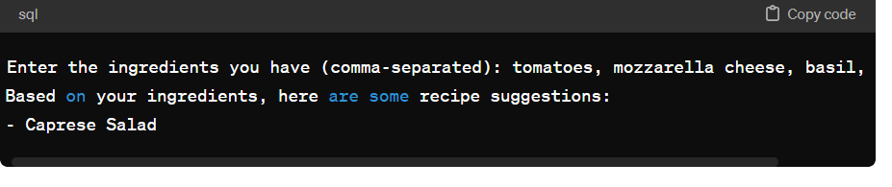

Slide 9
CONCLUSION :
In conclusion, the recipe application presented offers a personalized and convenient solution for individuals, especially those with limited cooking experience or knowledge. By enabling users to search for recipes based on the ingredients they already possess, the application addresses the common challenge of deciding what to cook with available resources. This functionality not only promotes resourcefulness but also reduces food waste by encouraging users to utilize existing ingredients effectively. . Moreover, the integration of image processing technology adds an innovative dimension to the user experience, allowing for seamless ingredient recognition and recipe suggestions based on scanned images, thereby simplifying the recipe discovery process further.

Slide 10
References
People who subscribe to meal plans do it for the sole reason of avoiding the effort and time required in ordering food daily. While that problem is solved by meal plan subscription services, there are a few issues that should be addressed for a good user experience.
In this case study, I’ll be sharing what those issues were and how I went about solving them with design.

